Slide 1


Artificial Intelligence and Data Science
Data Science and Visualization
24ADI204
DATA-VIZ HACK-A-BIT (2026-2027)
MID REVIEW (September 2026)
Team Number: 16
Title : CRIME HOTSPOT MAPPING
“Night Watch: Visualizing Crime Patterns for Safer Cities”

Slide 2
Problem Statement
Crime records contain useful information about crime type, time, location and administrative areas, but raw records require cleaning and structured analysis before meaningful patterns can be identified.
Large volumes of incident data make it difficult to understand where and when crimes are concentrated using raw tables alone.
The project transforms Chicago crime records into temporal and geographical insights through data cleaning, EDA, hotspot-oriented visualization and an interactive dashboard.

Slide 3
Project Objectives
Clean and prepare the Chicago Crime dataset for reliable analysis.
Handle missing values and validate geographical coordinates without unnecessarily losing useful records.
Perform univariate and bivariate EDA to identify patterns across crime type, time and location.
Identify periods and areas with higher concentrations of reported incidents.
Develop meaningful visualizations and a final interactive crime hotspot dashboard.
Convert large-scale crime records into clear, data-driven insights for understanding crime patterns.

Slide 4
Scope of the Project
Analyze Chicago crime incidents from 2001 to the present dataset release.
Data preparation: Missing-value handling, geographical-data separation, coordinate validation and outlier inspection.
EDA: Crime type, year, hour, day, domestic status, arrest status and location description.
Spatial analysis: Latitude/Longitude-based crime distribution and hotspot-oriented mapping.
Visualizations: Heatmaps, count plots, histograms, line charts, boxplots and spatial plots.
Final output: An interactive dashboard combining temporal, categorical and geographical insights.

Slide 5
Dataset Description
Dataset Source:
Kaggle – Chicago Crime Incidents (2001–Present)
Number of records:
1,242,357
Number of features:
22
Data type:
Structured tabular data (CSV)
Target variable:
No single target variable; this is an exploratory/hotspot-mapping project.
Important fields:
Date District
Ward Primary Type
Time Location Description
Community Area Domestic
Arrest
Description

Slide 6
Methodology(Process / Workflow)
  Data Collection:
Collect the raw Chicago Crime Incidents (2001–Present) dataset from Kaggle.
  Data Understanding:
Examine the dataset structure, data types, and key attributes.
Generate an initial data quality report.
  Data Preprocessing:
Handle missing values and duplicate records.
Format date and time fields.
Detect and treat outliers.
  Exploratory Data Analysis (EDA):
Analyze crime distribution by type, location, and time.
Identify trends, patterns, and correlations using statistical visualizations.

Slide 7
Methodology(Process / Workflow)
  Feature Engineering:
Extract features such as Year, Month, Day, Hour, and Time of Day.
Encode categorical variables and scale numerical features.
  Dimensionality Reduction:
Apply Principal Component Analysis (PCA) to reduce feature complexity while retaining important information.
  Dashboard Development:
Build an interactive dashboard with maps, charts, filters, and KPI cards using Streamlit/Power BI.
  Insights & Recommendations:
Identify crime hotspots, peak crime periods, and key crime patterns.
Provide actionable insights to support public safety and crime prevention.

Slide 8
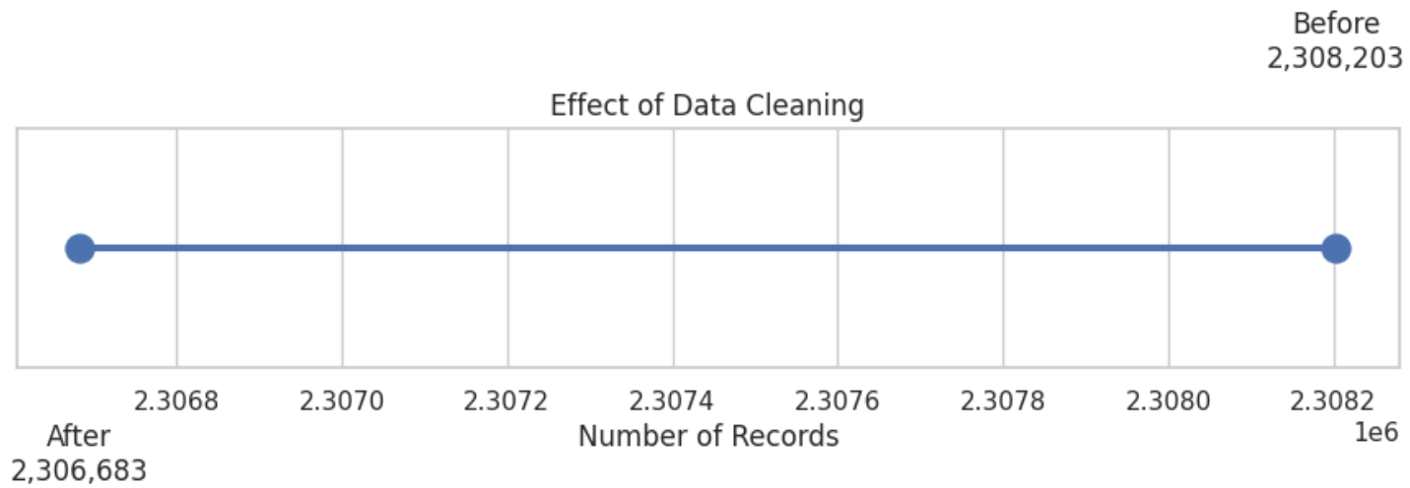
Results From Workflow
Before Cleaning:
Rows: 1,242,357
Columns: 22
Total null values: 1,316,724
After Selected Non-Geographical Cleaning
Rows: 1,240,850
Columns: 22
Total null values: 1,311,043
Records removed: 1,507 (~0.12%)
Geographical Data:
Latitude/Longitude handled separately for mapping
Coordinate ranges checked
Potential outliers inspected rather than blindly deleted

Slide 9
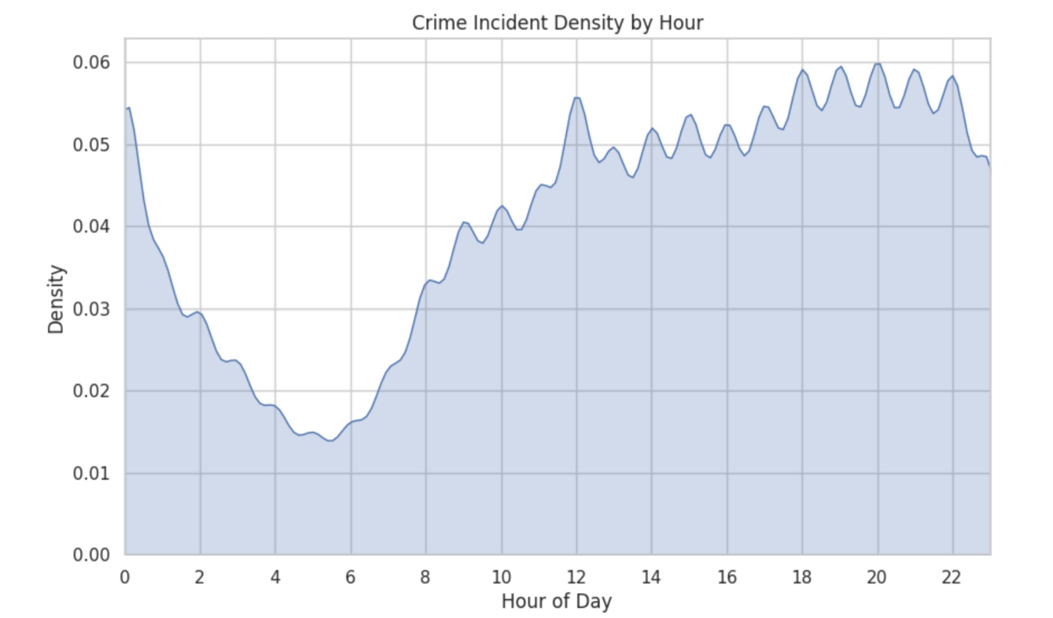
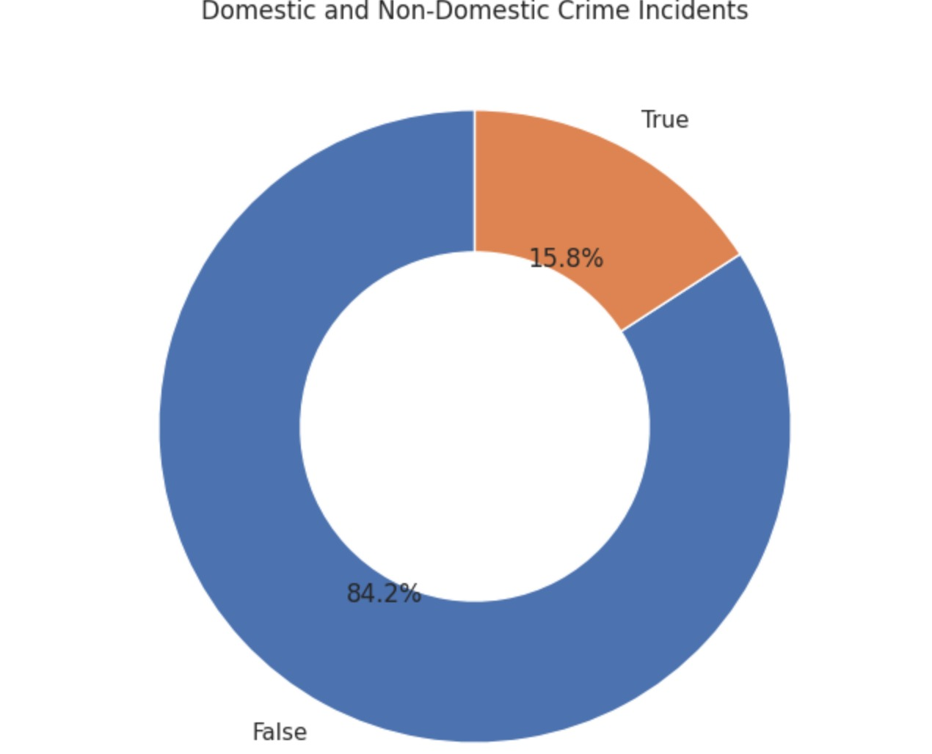
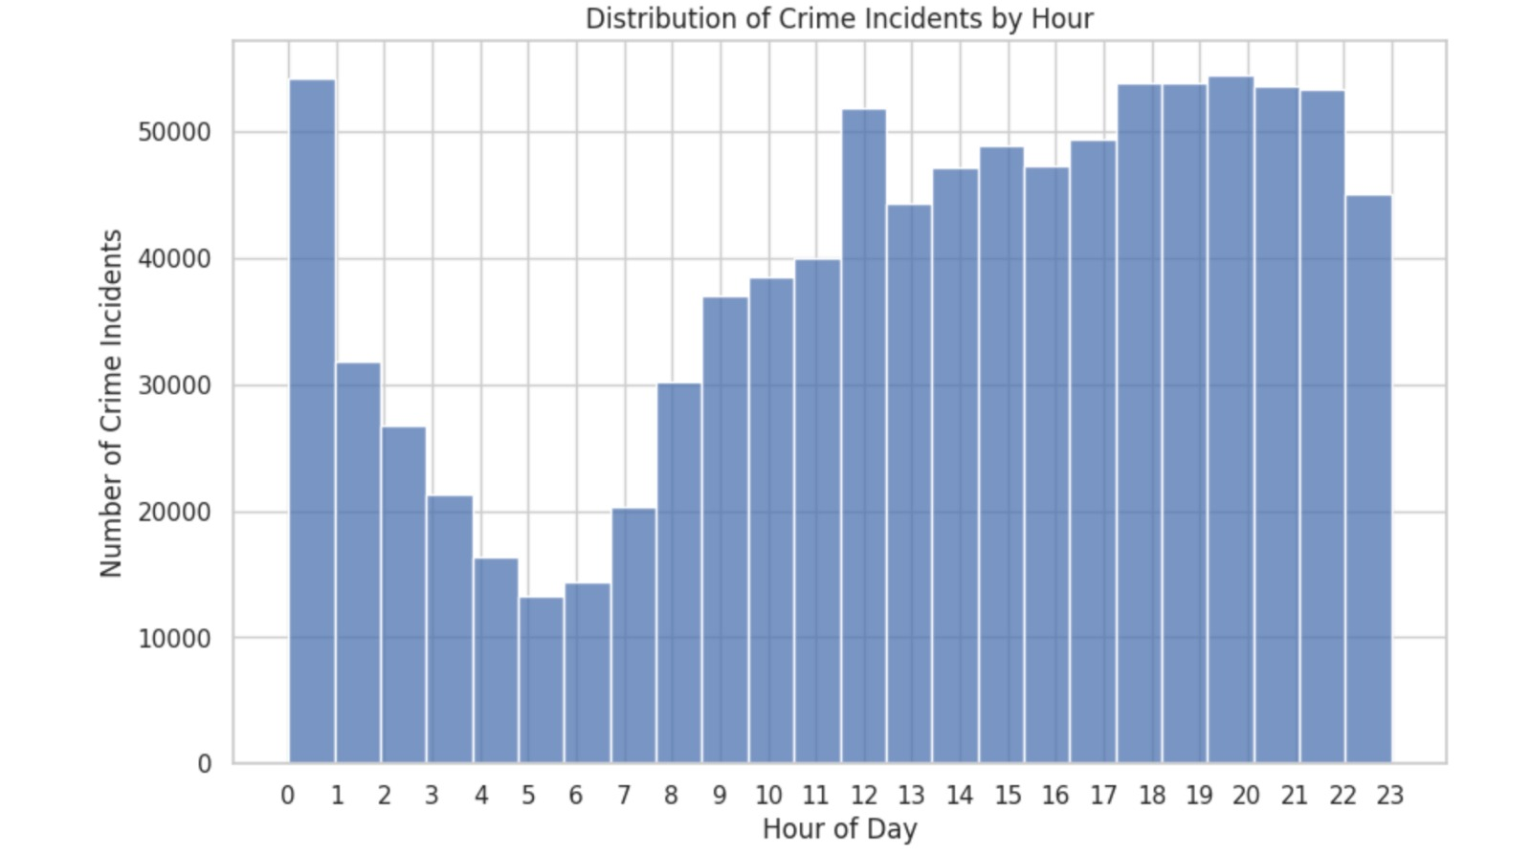
Results From Workflow
~Data Quality Improvements
Selected missing values handled
Geographical data treated separately
Coordinate validity and potential outliers checked
Dataset retained for spatial and non-spatial analysis
~Key EDA Focus
Crime patterns compared across type, time and location
Day/hour analysis used to identify high-activity periods
Spatial coordinates prepared for hotspot-oriented visualization

Slide 10
Expected Final Results
Clean Dataset – 1.24M+ records, ready for analysis.
Crime Insights – Identify major crime types, time and location patterns.
Hotspot Mapping – Visualize areas with higher crime concentration.
Interactive Dashboard – Filters for crime type, year, location, time and arrests.
Final Output: Interactive Crime Hotspot Mapping Dashboard

Slide 11
Roles & Responsibilities
Team Member | Contribution
Jyotika C R | Dataset research and source documentation Initial dataset exploration and structure checks Visualization development and EDA presentation Univariate and bivariate EDA
Keerthi Samyuktta J | Dataset cleaning and preprocessing Null-value analysis and geographical-data handling GitHub/project repository organization PPT and reports documentation

Slide 12
Challenges Faced
~Data Quality Issues
Large dataset with more than 1.2 million records
Missing values in administrative and geographical fields
~Outliers
Geographical/numerical values required validation before analysis
Unusual coordinates cannot be removed without checking whether they are genuine
~`Visualization Scale
Plotting very large numbers of points can reduce readability
Aggregation, heatmaps and filtered visualizations are preferred

Slide 13
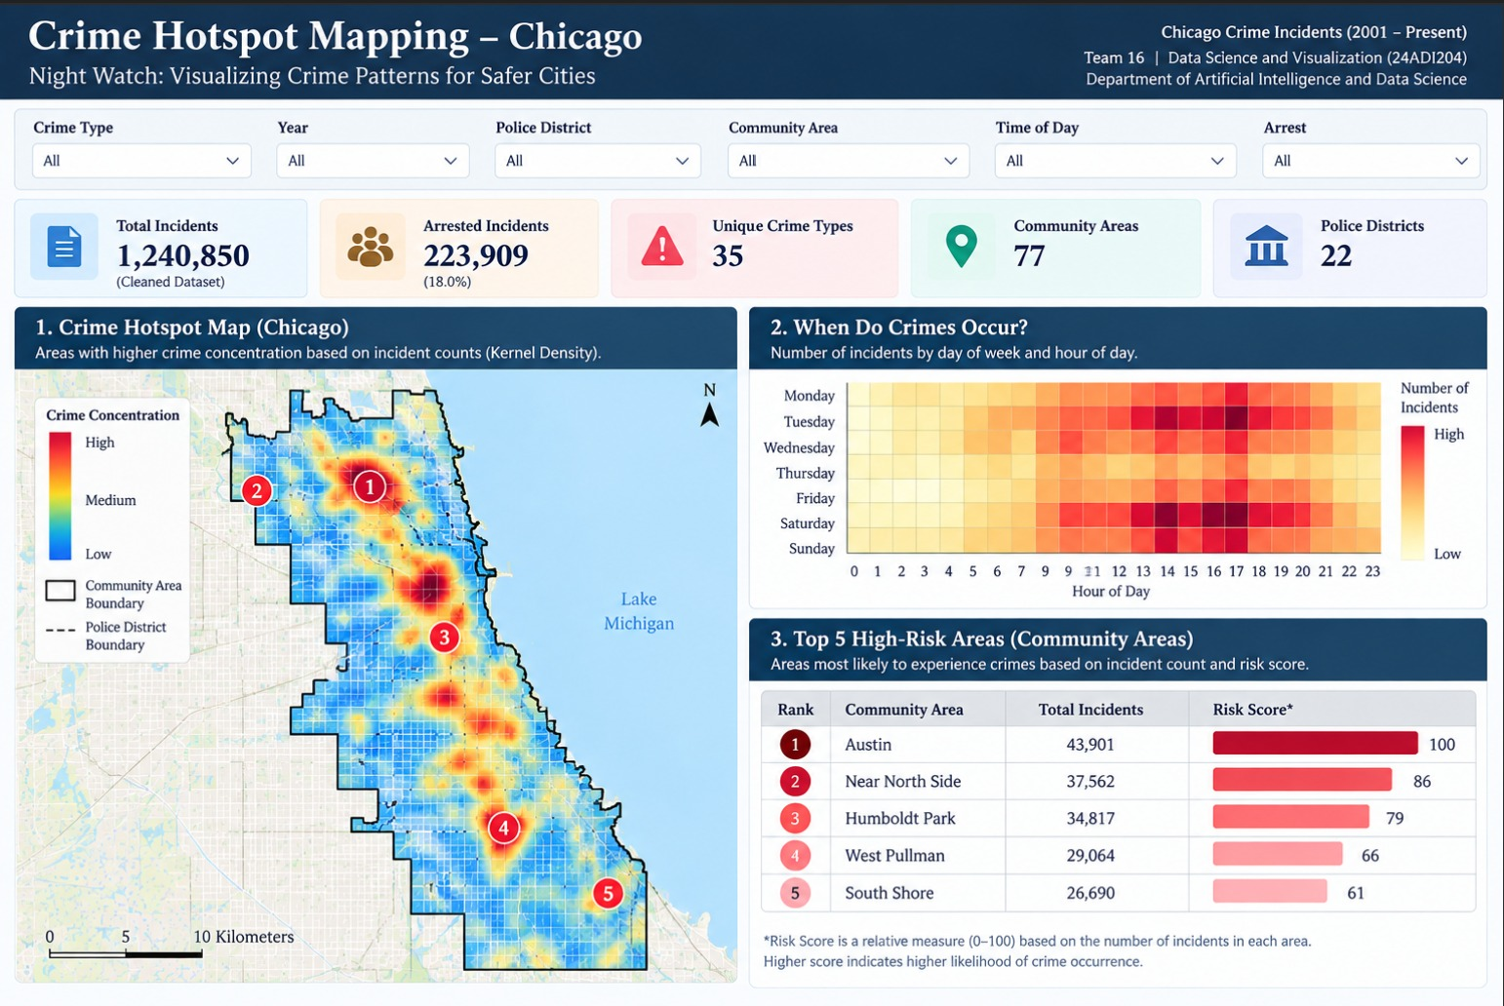
Future Work & Conclusion
Feature engineering: Hour, Day, Month and other useful time/location features
Advanced spatial analysis and hotspot identification
Interactive filters and map-based exploration
Build the final dashboard and integrate major findings
Refine visual design and validate dashboard usability

Slide 14
References
Chicago Crime Incidents (2001–Present), Kaggle dataset selected for the project.
Data Science and Visualization (24ADI204), DATA-VIZ HACK-A-BIT (2026–2027) project template.
Python libraries:
  Pandas
  NumPy
  Matplotlib
  Seaborn
Team GitHub repository – project notebooks, reports and cleaned-data workflow.
Git hub link: https://github.com/keerthisamyuktta-byte/24ADI204_DSV_Team16

